Slide 1
Chapter 3
Regular Languages And Regular Grammar

Slide 2
Outline
Regular Sets and Regular Expressions
Algebraic Laws for Regular Expressions
Conversion of FA to Regular Expressions and vice versa
Pumping Lemma and Applications
Closure Properties of Regular Languages
Regular Grammars
Right Linear and Left Linear Grammars
Equivalence between Regular Linear Grammar and FA
Inter-conversion

Slide 3
Regular Sets and Regular Expressions
What sets can be recognized by a Finite State Automata?
Regular Sets
What are Regular Sets?
Definition: A regular set is a set that can be generated starting from the empty set, empty string, and single elements from the alphabet, using concatenations, unions, and Kleene closures in arbitrary order.
We will give a more precise definition after we define a regular expression.

Slide 4
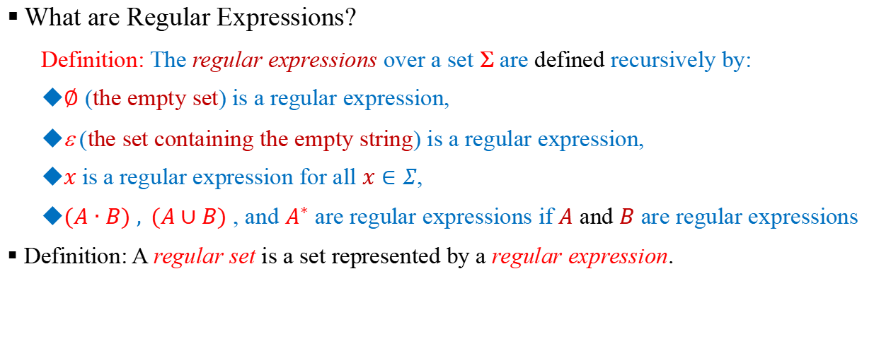
Regular Sets and Regular Expressions
What are Regular Expressions?
Definition: The regular expressions over a set Σ are defined recursively by:
$∅$ (the empty set) is a regular expression,
ε (the set containing the empty string) is a regular expression,
$x$ is a regular expression for all $x∈Σ$,
$(A∙B)$ $, (A∪B)$ , and $A^{∗}$ are regular expressions if $A$ and $B$ are regular expressions
Definition: A regular set is a set represented by a regular expression.

Slide 5
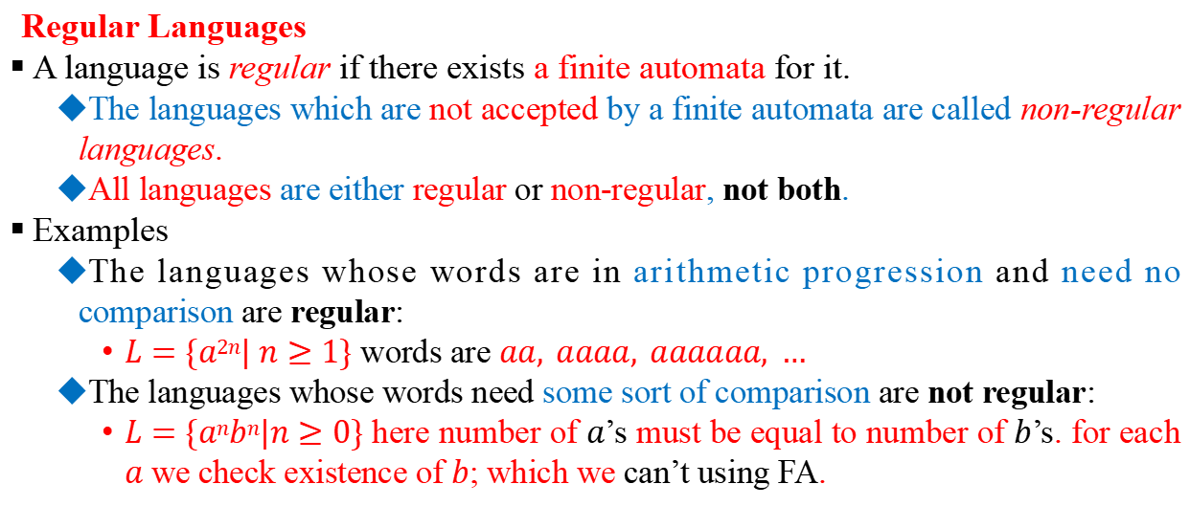
Regular Sets and Regular Expressions
Regular Languages
A language is regular if there exists a finite automata for it.
The languages which are not accepted by a finite automata are called non-regular languages.
All languages are either regular or non-regular, not both.
Examples
The languages whose words are in arithmetic progression and need no comparison are regular:
$L=\{a2n| n≥1\}$ words are $aa, aaaa, aaaaaa, …$
The languages whose words need some sort of comparison are not regular:
$L=\{anbn|n≥0\}$ here number of $a$’s must be equal to number of $b$’s. for each $a$ we check existence of $b$; which we can’t using FA.

Slide 6
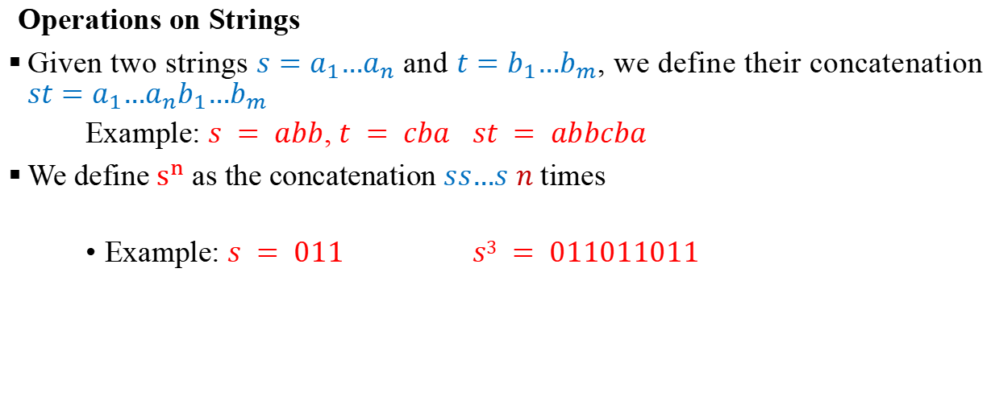
Regular Sets and Regular Expressions
Operations on Strings
Given two strings $s=a_{1}…a_{n}$ and $t=b_{1}…b_{m}$, we define their concatenation $st=a_{1}…a_{n}b_{1}…b_{m}$
Example: $s = abb$, $t = cba$ $st = abbcba$
We define $s^{n}$ as the concatenation $ss…s$ $n$ times
Example: $s = 011$ $s3 = 011011011$

Slide 7
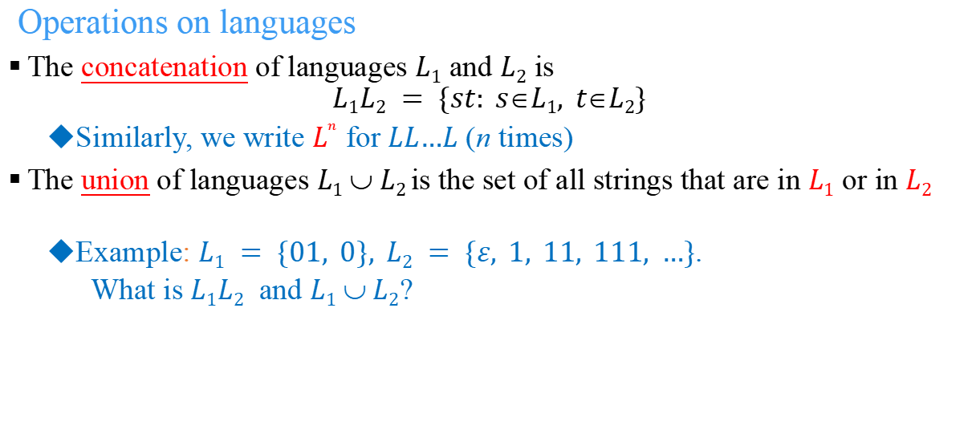
Regular Sets and Regular Expressions
Operations on languages
The concatenation of languages $L1$ and $L2$ is
$$L1L2 = \{st: sL1, tL2\}$$
Similarly, we write $L^{n}$ for $LL…L$ (n times)
The union of languages $L1  L2$is the set of all strings that are in $L1$ or in $L2$
Example: $L1 = \{01, 0\}, L2 = \{ε, 1, 11, 111, …\}$.
What is $L1L2$ and $L1  L2$?

Slide 8
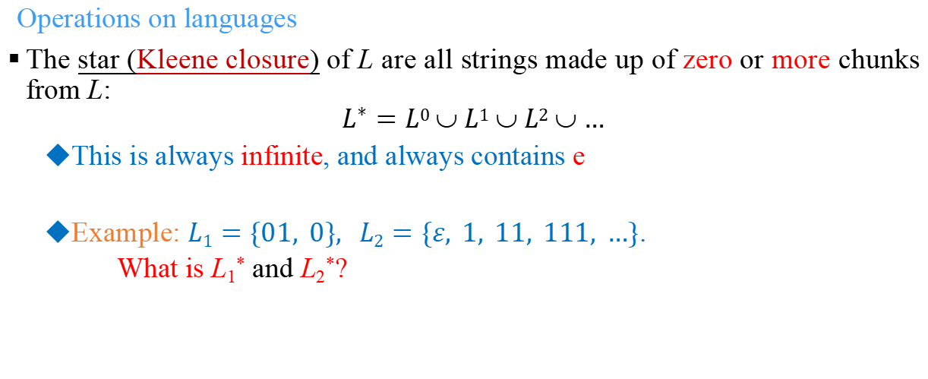
Regular Sets and Regular Expressions
Operations on languages
The star (Kleene closure) of L are all strings made up of zero or more chunks from L:
$$L^{∗}=L0  L1  L2  …$$
This is always infinite, and always contains e
Example: $L1=\{01, 0\}, L2=\{ε, 1, 11, 111, …\}$.
What is L₁* and L₂*?

Slide 9
Regular Sets and Regular Expressions
Constructing languages with operations
Let’s fix an alphabet, say S = {0, 1}
We can construct languages by starting with simple ones, like {0}, {1} and combining them
{0}({0}∪{1})* all strings that start with 0
0(0+1)*
({0}{1}*)∪({1}{0}*)
01*+10*

Slide 10
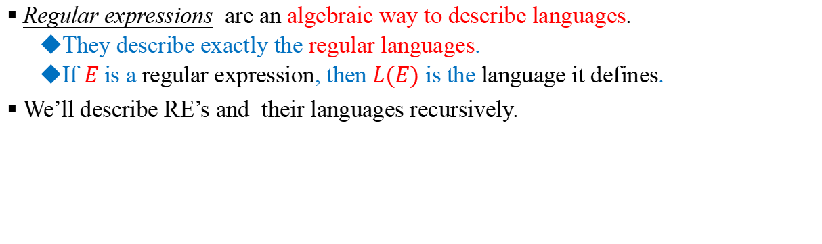
Algebraic Laws for Regular Expressions
Regular expressions are an algebraic way to describe languages.
They describe exactly the regular languages.
If $E$ is a regular expression, then $L(E)$ is the language it defines.
We’ll describe RE’s and their languages recursively.
A language is regular if it is represented by a regular expression

Slide 11
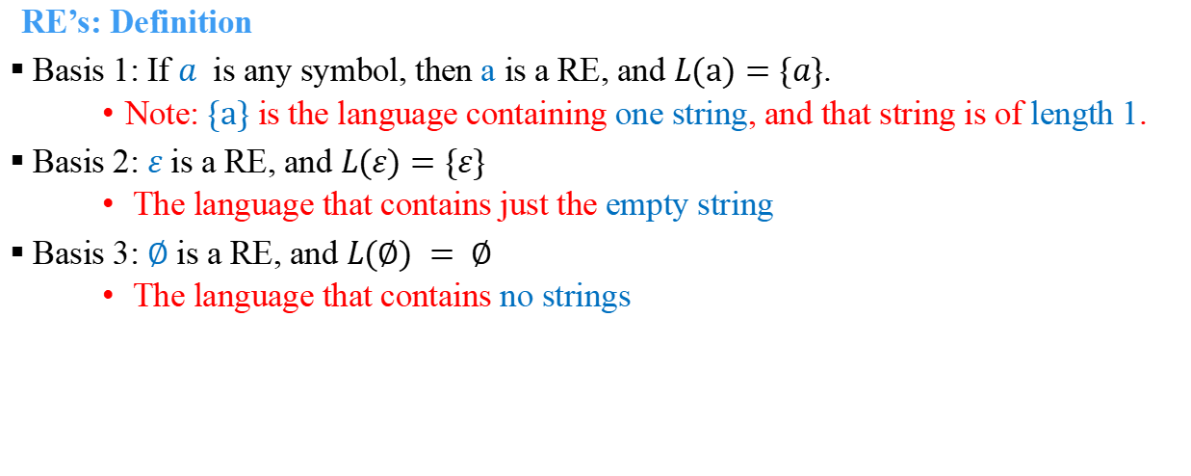
Algebraic Laws for Regular Expressions
RE’s: Definition
Basis 1: If $a$ is any symbol, then a is a RE, and $L(\text{a})=\{a\}$.
Note: $\{\text{a}\}$ is the language containing one string, and that string is of length 1.
Basis 2: $ε$ is a RE, and $L(ε)=\{ε\}$
The language that contains just the empty string
Basis 3: $∅$ is a RE, and $L(∅) = ∅$
The language that contains no strings

Slide 12
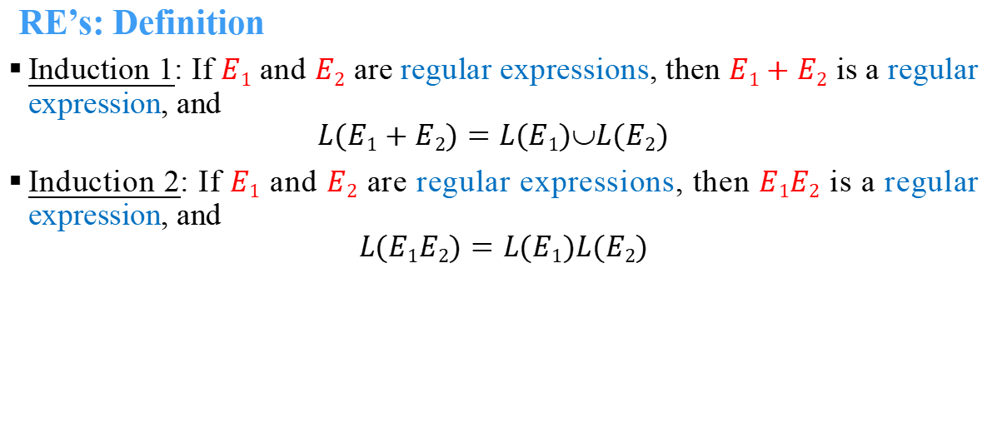
Algebraic Laws for Regular Expressions
RE’s: Definition
Induction 1: If $E1$ and $E2$ are regular expressions, then $E1+E2$ is a regular expression, and
$$L(E1+E2)=L(E1)L(E2)$$
Induction 2: If $E1$ and $E2$ are regular expressions, then $E1E2$ is a regular expression, and
$$L(E1E2)=L(E1)L(E2)$$
Concatenation : the set of strings $wx$ such that $w$ is in $L(E1)$ and $x$ is in $L(E2)$.

Slide 13
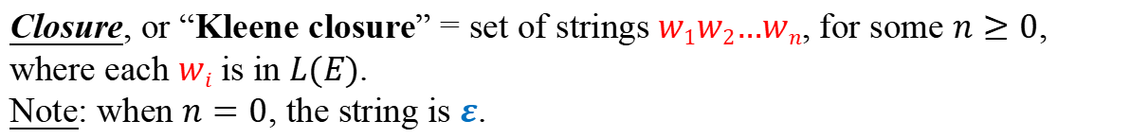

Algebraic Laws for Regular Expressions
RE’s: Definition
Induction 3: If $E$ is a RE, then $E^{∗}$ is a RE, and
$$L(E^{∗}) = {(L(E))}^{∗}$$
Closure, or “Kleene closure” = set of strings$w1w2…wn$, for some $n≥0$, where each $wi$ is in $L(E)$.
Note: when $n=0$, the string is $ε$.

Slide 14
Algebraic Laws for Regular Expressions
Precedence of Operators
Parentheses may be used wherever needed to influence the grouping of operators.
Order of precedence is:
* (Kleene closure)….[highest priority], then concatenation, then + (Union) ….[lowest].

Slide 15
Algebraic Laws for Regular Expressions
Algebraic Laws
Union and concatenation behave sort of like addition and multiplication.
+ is commutative and associative;
concatenation is associative.
Concatenation distributes over +.
Exception: Concatenation is not commutative.
Identities and Annihilators
∅ is the identity for +.
R + ∅ = R.
ε is the identity for concatenation.
εR = Rε = R.
∅ is the annihilator for concatenation.
∅R = R∅ = ∅.

Slide 17
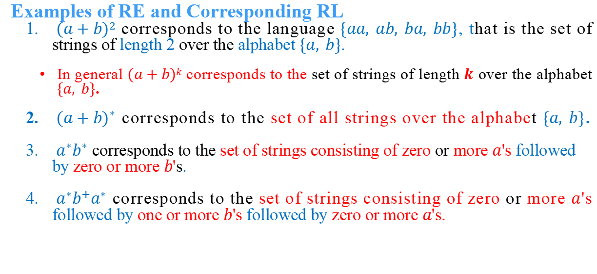
Algebraic Laws for Regular Expressions
Examples of RE and Corresponding RL
$(a+b)2$ corresponds to the language $\{aa, ab, ba, bb\}$, that is the set of strings of length 2 over the alphabet $\{a, b\}$.
In general $(a+b)k$ corresponds to the set of strings of length $k$ over the alphabet $\{a, b\}$.
${(a+b)}^{∗}$ corresponds to the set of all strings over the alphabet $\{a, b\}$.
$a^{∗}b^{∗}$ corresponds to the set of strings consisting of zero or more $a$'s followed by zero or more $b$'s.
$a^{∗}b^{+}a^{∗}$ corresponds to the set of strings consisting of zero or more $a$'s followed by one or more $b$'s followed by zero or more $a$'s.

Slide 18
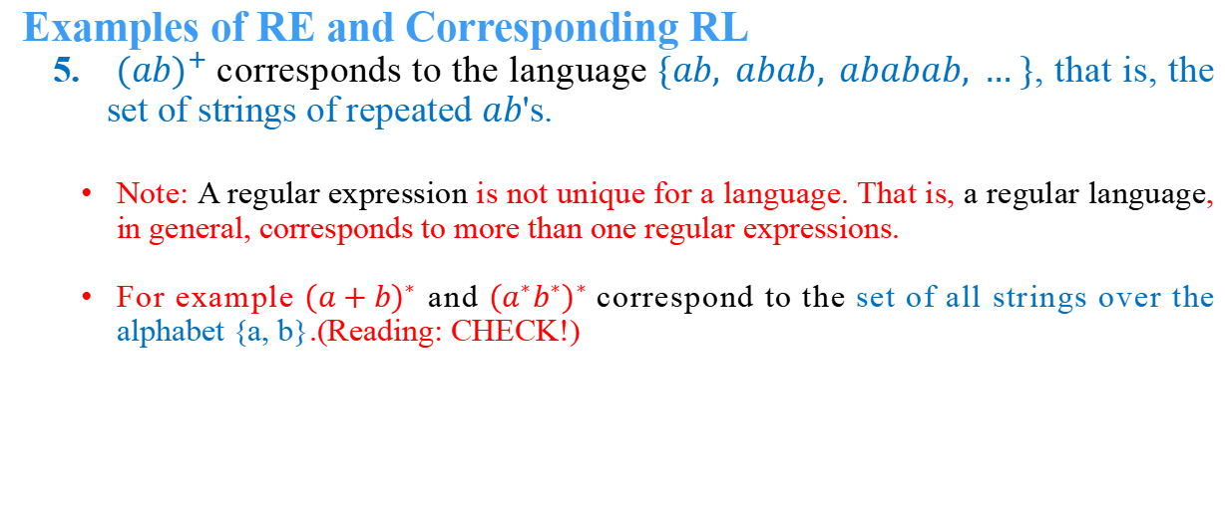
Algebraic Laws for Regular Expressions
Examples of RE and Corresponding RL
${(ab)}^{+}$corresponds to the language $\{ab, abab, ababab, … \}$, that is, the set of strings of repeated $ab$'s.
Note: A regular expression is not unique for a language. That is, a regular language, in general, corresponds to more than one regular expressions.
For example ${(a+b)}^{∗}$ and ${(a}^{∗}b^{∗})^{∗}$correspond to the set of all strings over the alphabet {a, b}.(Reading: CHECK!)

Slide 19
Algebraic Laws for Regular Expressions
Examples of RE and Corresponding RL
(01) = {01}.
(01+0) = {01, 0}.
(0(1+0)) = {01, 00}.
Note order of precedence of operators.
(0*) = {ε, 0, 00, 000,… }.
((0+10)*1) = all strings of 0’s and 1’s without two consecutive 1’s.
01* = {0, 01, 011, 0111, …..}
(01*)(01) = {001, 0101, 01101, 011101, …..}

Slide 20
Examples
Construct a RE over Σ = {0,1} that represents
All strings that have two consecutive 0s.
All strings except those with two consecutive 0s.
All strings with an even number of 0s.
(0+1)*00(0+1)*
(1*01)*1* + (1*01)*1*0
(1*01*01*)*

Slide 21
Examples
The set of strings over {0,1} that end in 3 consecutive 1's.
(0 + 1)* 111
The set of strings over {0,1} that have at least one 1.
0* 1 (0 + 1)*
The set of strings over {0,1} that have at most one 1.
0* + 0* 1 0*
All strings over {0,1} that start and end with the same digit
0(0+1)*0 + 1(0+1)*1 + 0 + 1

Slide 22
Conversion of FA to RE and Vice Versa
For every regular expression, we have to give a DFA for the same language
For every DFA, we give a regular expression for the same language
regular expression
εNFA
DFA
NFA

Slide 23
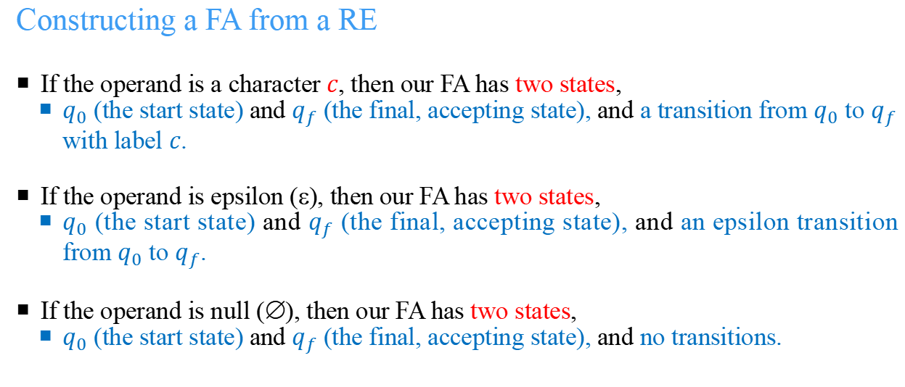
Conversion of FA to RE and Vice Versa
Constructing a FA from a RE
If the operand is a character $c$, then our FA has two states,
$q_{0}$ (the start state) and $q_{f}$ (the final, accepting state), and a transition from $q_{0}$ to $q_{f}$ with label $c$.
If the operand is epsilon (ε), then our FA has two states,
$q_{0}$ (the start state) and $q_{f}$ (the final, accepting state), and an epsilon transition from $q_{0}$ to $q_{f}$.
If the operand is null (∅), then our FA has two states,
$q_{0}$ (the start state) and $q_{f}$ (the final, accepting state), and no transitions.

Slide 24
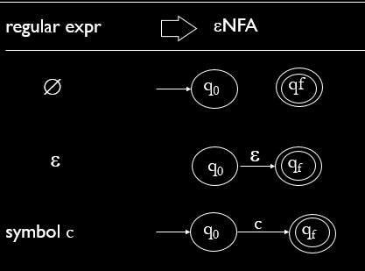
Conversion of FA to RE and Vice Versa
Constructing a FA from a RE

Slide 25
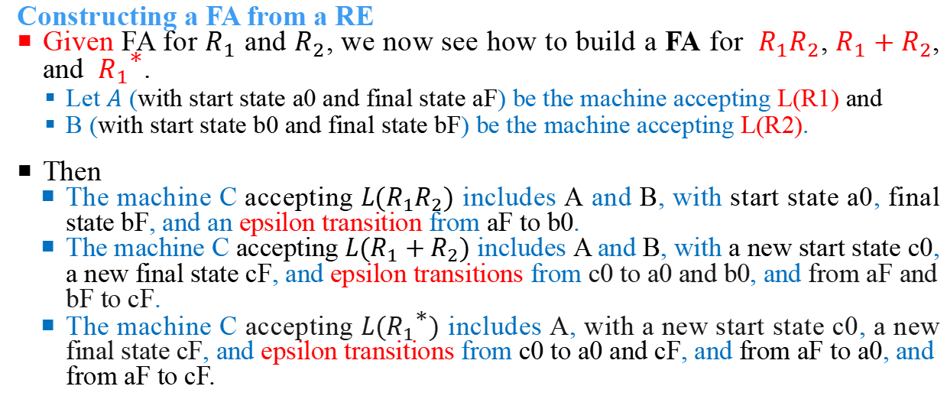
Conversion of FA to RE and Vice Versa
Constructing a FA from a RE
Given FA for $R_{1}$ and $R_{2}$, we now see how to build a FA for$R_{1}R_{2}$, $R_{1}+R_{2}$, and ${R_{1}}^{\text{∗}}$.
Let $A$ (with start state a0 and final state aF) be the machine accepting L(R1) and
B (with start state b0 and final state bF) be the machine accepting L(R2).
Then
The machine C accepting $L(R_{1}R_{2})$ includes A and B, with start state a0, final state bF, and an epsilon transition from aF to b0.
The machine C accepting $L(R_{1}+R_{2})$ includes A and B, with a new start state c0, a new final state cF, and epsilon transitions from c0 to a0 and b0, and from aF and bF to cF.
The machine C accepting $L({R_{1}}^{\text{∗}})$ includes A, with a new start state c0, a new final state cF, and epsilon transitions from c0 to a0 and cF, and from aF to a0, and from aF to cF.

Slide 26
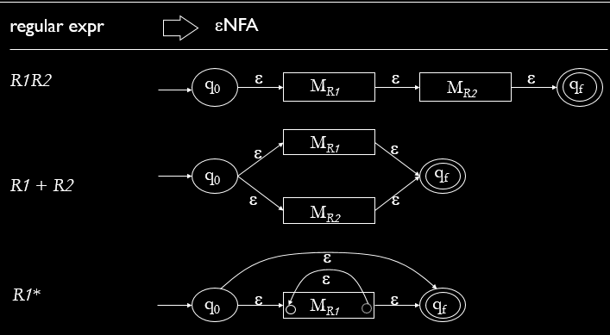
Conversion of FA to RE and Vice Versa
Constructing a FA from a RE

Slide 27
Examples: regular expression → εNFA
R₁ = 0 R₂ = 1
R₃ =0 + 1
=R₁+R₂
R₄ = (0 + 1)*
=R₃*
q₀
1
q_{f}
q₀
0
q_{f}
q₂
0
q₃
ε
ε
q₀
q₁
ε
q₄
1
q₅
ε
ε
ε
q’₀
ε
M₃
ε
q’₁

Slide 28
Convention
When we draw a box around an eNFA:
The arrow going in points to the start state
The arrow going out represents all transitions going out of accepting states
None of the states inside the box are accepting states.
The labels of the states inside the box are distinct from all other states in the diagram

Slide 29
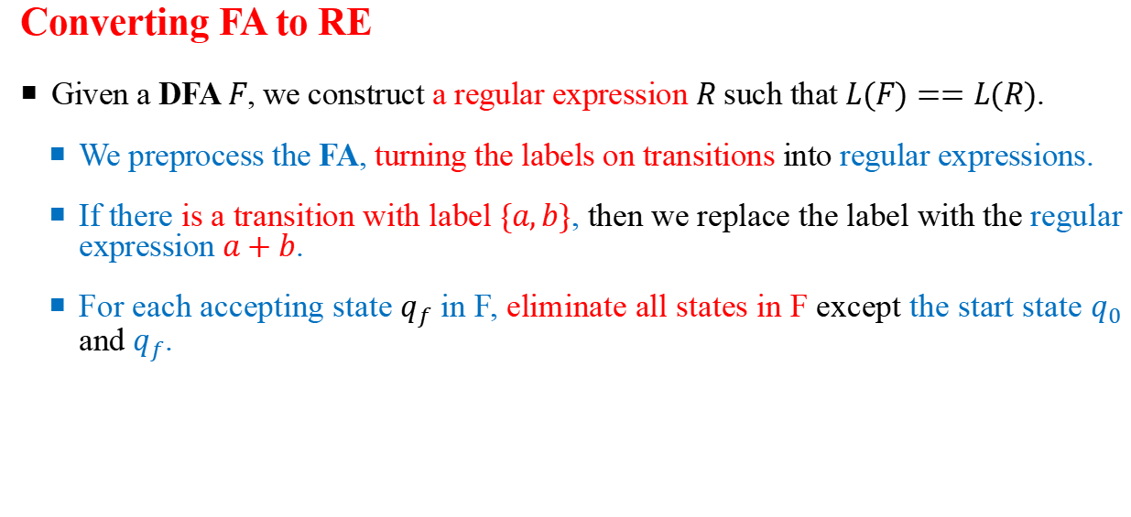
Conversion of FA to RE and Vice Versa
Converting FA to RE
Given a DFA $F$, we construct a regular expression $R$ such that $L(F)==L(R)$.
We preprocess the FA, turning the labels on transitions into regular expressions.
If there is a transition with label $\{a,b\}$, then we replace the label with the regular expression $a+b$.
For each accepting state $q_{f}$ in F, eliminate all states in F except the start state $q_{0}$ and $q_{f}$.

Slide 30
Conversion of FA to RE and Vice Versa
Converting FA to RE
To eliminate a state qE, consider all pairs of states qA and qB such that
there is a transition from qA to qE with label R1,
a transition from qE to qE with label R2 (possibly null, meaning no transition), and
a transition from qE to qB with label R3.
Introduce a transition from qA to qB with label R1R2*R3.
If there is already a transition from qA to qB with label R4, then replace that label with R4+R1R2*R3.

Slide 31
Conversion of FA to RE and Vice Versa
Converting FA to RE
After eliminating all states except q0 and qf:
If q0 == qf, then the resulting regular expression is R1*, where R1 is the label on the transition from q0 to q0.
If q0 != qf, then assume
the transition from q0 to q0 is labeled R1,
the transition from q0 to qf is labeled R2,
the transition from qf to qf is labeled R3, and
the transition from qf to q0 is labeled R4.
The resulting regular expression is R1*R2(R3 + R4R1*R2)*

Slide 32
Conversion of FA to RE and Vice Versa
Converting FA to RE
Let RF_{i} be the regular expression produced by eliminating all the states except q0 and qfi, and
If there are n final states in the DFA, then the regular expression that generates the strings accepted by the original DFA is RF1 + RF2 + ... RFn.

Slide 33
Example
Construct regular expression for these FA:
0
1
0
1
0,1
1
q₁
q₂
1
0
q₀
q₁
q₂
0
0*11*
ε+0*+(0*11*00*) *

Slide 34
Example
Construct regular expression for these FA:
1
0
0
0,1
q₀
0
q₁
1
1
q₀
q₁
q₂
ε
1
q₂
0*10*1(0+1) *
01*+1

Slide 35
Example
Construct FA for these regular expressions :
0*1*2 *
1*0(1*+01*0) *
0
1
2
1
1
ε
ε
0
q₀
q₁
q₂
q₀
q₁
0

Slide 36
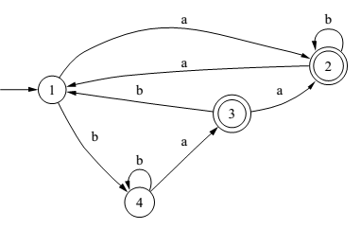
Homework
Construct RE for the following Finite Automata

Slide 37
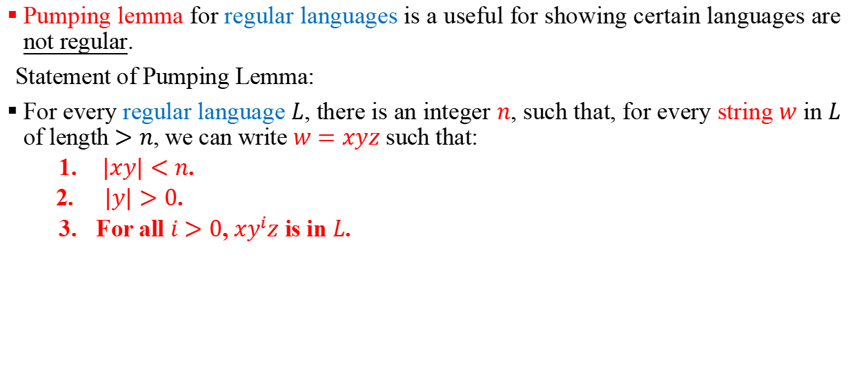
Pumping Lemma and Applications
Pumping lemma for regular languages is a useful for showing certain languages are not regular.
Statement of Pumping Lemma:
For every regular language $L$, there is an integer $n$, such that, for every string $w$ in $L$ of length $>n$, we can write $w=xyz$ such that:
$|xy|<n$.
$|y|>0$.
For all $i>0$, $xy^{i}z$ is in $L$.

Slide 38
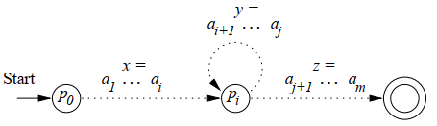
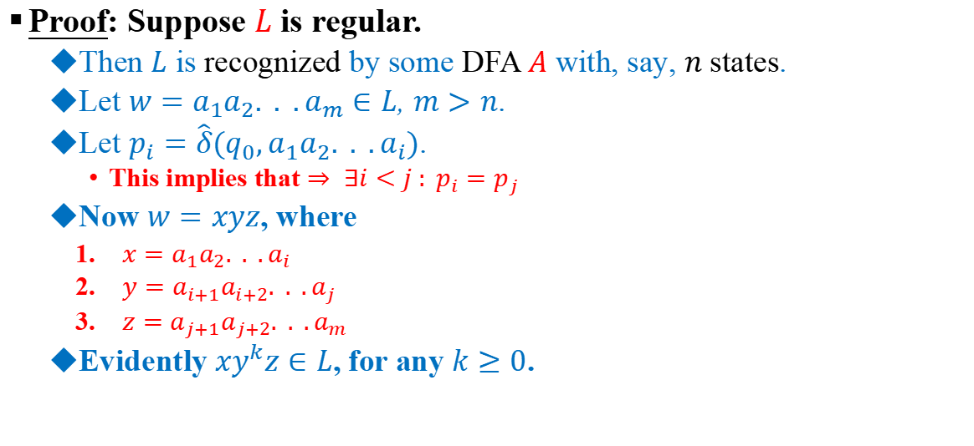
Pumping Lemma and Applications
Proof: Suppose $L$ is regular.
Then $L$ is recognized by some DFA $A$ with, say, $n$ states.
Let $w=a_{1}a_{2}. . .a_{m}∈L$, $m>n$.
Let $p_{i}=\hat{δ}(q_{0},a_{1}a_{2}. . .a_{i})$.
This implies that $⇒ ∃i<j : p_{i}=p_{j}$
Now $w=xyz$, where
$x=a_{1}a_{2}. . .a_{i}$
$y=a_{i+1}a_{i+2}. . .a_{j}$
$z=a_{j+1}a_{j+2}. . .a_{m}$
Evidently $xy^{k}z∈L$, for any $k≥0$.

Slide 39

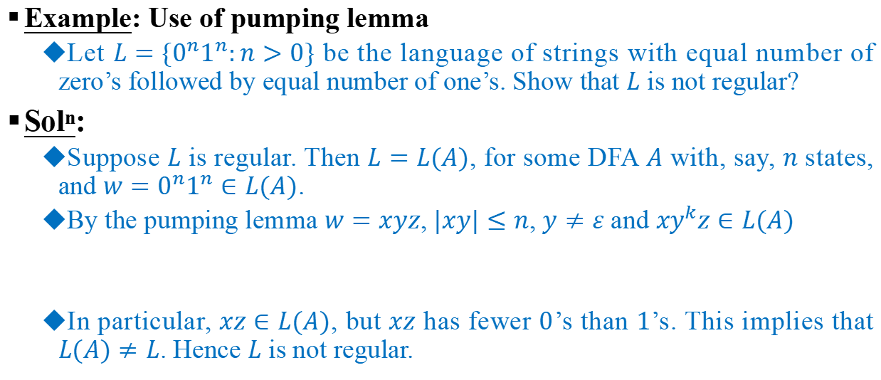
Pumping Lemma and Applications
Example: Use of pumping lemma
Let $L=\{0^{n}1^{n}:n>0\}$ be the language of strings with equal number of zero’s followed by equal number of one’s. Show that $L$ is not regular?
Sol^{n}:
Suppose $L$ is regular. Then $L=L(A)$, for some DFA $A$ with, say, $n$ states, and $w=0^{n}1^{n}∈L(A)$.
By the pumping lemma $w=xyz$, $|xy|≤n$, $y≠ε$ and $xy^{k}z∈L(A)$
In particular, $xz∈L(A)$, but $xz$ has fewer $0$’s than $1$’s. This implies that $L(A)≠L$. Hence $L$ is not regular.

Slide 40
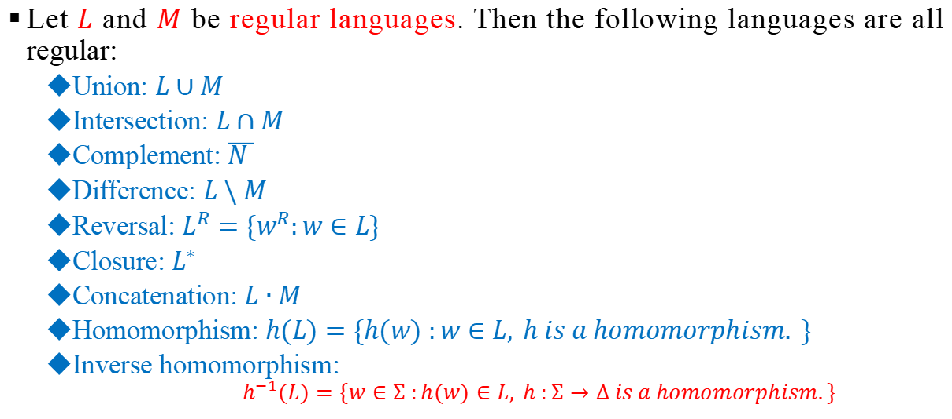
Closure Properties of Regular Languages
Let $L$ and $M$ be regular languages. Then the following languages are all regular:
Union: $L∪M$
Intersection: $L∩M$
Complement: $\overline{N }$
Difference: $L\backslash M$
Reversal: $L^{R}=\{w^{R}:w∈L\}$
Closure: $L^{∗}$
Concatenation: $L∙M$
Homomorphism: $h(L)=\{h(w) :w∈L, h is a homomorphism. \}$
Inverse homomorphism:
$$h^{−1}(L)=\{w∈Σ :h(w)∈L, h :Σ→∆ is a homomorphism.\}$$
Note: Proof is left as an assignment

Slide 41
Regular Grammars

Slide 42
Grammars
For natural languages, each has its own grammar.
An Amharic sentence follows Amharic language grammar.
For programming languages, A C++ program has to obey the C++ programming grammar.
A regular language can be accepted by a finite state automaton and denoted by a regular expression.
In this section, we shall show that a regular language can be generated by a regular grammar.

Slide 43
Grammars
Grammars express languages
Example: The English language

Slide 44
Grammars

Slide 45
Grammars
A derivation of “the boy walks”:

Slide 46
Grammars
A derivation of “a dog runs”:

Slide 47
Grammars
Language of the grammar:
L = { “a boy runs”,
“a boy walks”,
“the boy runs”,
“the boy walks”,
“a dog runs”,
“a dog walks”,
“the dog runs”,
“the dog walks” }

Slide 48
Grammars
Notation:
Variable
or
Non-terminal
Terminal
Production rule

Slide 49
Another Example
Grammar:
Derivation of sentence :

Slide 50
Grammar:
Derivation of sentence :

Slide 51
Other derivations:

Slide 52
Grammars
Definition: A grammar G = (V, T, P, S) is defined as follows.
(1) V is a finite set of variables. S is the start symbol in V.
(2) T is a finite set of terminals, and T ∩ V = ∅.
(3) P is a finite set of productions or rewriting rules.
Each production is of the form:
A → aB, where A, B ∈ V and a ∈ T, or
A → a, where A ∈ V and a ∈ T.

Slide 53
A Non-Linear Grammar
Has the production rules like:

Slide 54
Linear Grammars
Grammars with at most one variable at the right side of a production
Examples:

Slide 55
Another Linear Grammar
Grammar:

Slide 56
Right-Linear Grammars (RLG)
All productions have the form:
Example:
or
string of terminals

Slide 57
Left-Linear Grammars (LLG)
All productions have the form:
Example:
or
string of terminals

Slide 58
Regular Grammars
A regular grammar is any right-linear or left-linear grammar
Examples:

Slide 59
Language of a Regular Grammar
The language generated by a regular grammar
G = (V, T, P, S) is denoted by L(G).
Example: Find L(G) for G = (V, T, P, S), where V = {S, A, B}, T = {0, 1} and P contains the following productions:
S → 0A | 1B | 1
A → 0S | 1B | 1
B → 0B | 1A | 0

Slide 60
Language of a Regular Grammar
Solution: The set generated by a regular grammar G is Produced by applying the production rules until all the variables are reduced to terminals.
P: S → 0A | 1B | 1, A → 0S | 1B | 1, B → 0B | 1A | 0
{ω ∈ {0, 1}* | ω has odd number of 1’s}.
S → 0A
→ 01B
→ 010B
→ 0101A
→ 01011
S → 1B
→ 10B
→ 100
S → 0A
→ 01

Slide 61
Example
S → aS | bA
A → cA | ε
This grammar produces the language produced by the regular expression a*bc*
S → aS → aaS → … → a…aS →a…abA →a…abcA
→ a…abccA → … → a…abc…c

Slide 62
Reg. Grammars Vs Reg. Languages
Right Linear Grammars are equivalent to εNFA
Two directions:
Given a Right Linear grammar, we can construct an εNFA that recognizes the same language with the Right Linear grammar.
Given an εNFA, we can construct a Right Linear grammar that describes the same language with the εNFA.

Slide 63
1. RLG→ εNFA
Suppose that we have a right linear grammar (V, Σ, P, S). construct an εNFA (Q, Σ, δ, S, {f}).
The set of states Q will be the set VU{f}, where f is a new symbol denoting the final state
Productions in P have three possible forms:
A → ε : add the transition δ(Α,ε) = f
A → a : add the transition δ(A,a) = f
A → aB : add the transition δ(Α,a) = B

Slide 64
2. εNFA → RLG
Suppose that We have an εNFA (Q, Σ, δ, q₀, F,). construct a right linear grammar (Q, Σ, P, q₀).
For each transition δ(q_{i} ,a) = q_{j}, construct the rule q_{i} → aq_{j} in P.
Furthermore, for every state q_{i} in F, add the rule q_{i} → ε in P.

Slide 65
Examples
Transform the following Right Linear grammar into an equivalent εNFA.
S → aS |bA
A → cA | ε
Solution:
a
c
S
b
Α
ε
f

Slide 66
Examples
2) Transform the following DFA to a right linear grammar
Solution:
Q₀ → aQ₁ | bQ₀
Q₁ → aQ₁ |bQ₀ | ε
b
q₀
a
q₁
b
a

Slide 67
Left Linear Grammars
Left Linear Grammars also produce the Regular Languages but not straightforward.
Actually, a Left Linear grammar produces the reverse of the language produced by the Right Linear grammar in which we reversed the rules:
A → Ba to A →aB.

Slide 68
Example
C → Bc
B → Ab
A → a
The derivation of abc is:
C → Bc → Abc → abc
The Right Regular grammar with the rules of the form A → Ba reversed is
C → cB
B → bA
A → a
and it produces the reverse language.
C → cB → cbA → cba and then take the reverse.

Slide 69
Example (continued)
So, just create the εNFA for the language produced by the Right Regular grammar and then compute the reverse (change start with final state and reverse the arrows).
This results in an εNFA for the Left Regular grammar.

Slide 70
Note:
A DFA can recognize a regular language.
A regular expression can represent a regular language.
A regular grammar can generate a regular language.

Slide 71
Exercise
Given the following English grammar.
S →NP VP
VP → V NP
NP → NAME
NP → DET N
NAME → Abebe
V → killed
DET → the
N → lion
Show the generaiton of the sentence Abebe killed the lion
Answer:
S ⇒NP VP
⇒ NAME VP
⇒ Abebe VP
⇒ Abebe V NP
⇒ Abebe killed NP
⇒ Abebe killed DET N
⇒ Abebe killed the N
⇒ Abebe killed the lion

Slide 72
Home work
Create a regular grammar for the language of strings over {a, b} which contains the substring aa.
Create NFA’s for the following languages and construct the corresponding regular grammars. Use S as the first non-terminal.
(a) (1+0)∗01∗
(b) {w| w ∈ {0,1} ∗ and w doesn’t end in 01}

Slide 73
Home work
Construct the equivalent DFA for the grammar having the following productions:
A →0A|1B
B →0C|1B
C →0B|1D| ε
D →0D|1D
Construct the RLG and LLG for the regular expression: a(a+b)*ab.
Hint: for LLG, reverse the regular expression, find its RLG, then change the terminals with variables in the right side of P.

Slide 74
Home work
State and Prove the Pumping Lemma?
Why we use it for?
How do we use it?

Slide 75
Thanks!!!

